Slide 1
KHATRA ADIBASI MAHAVIDYALAYA
B.A Program in Physical Education
Name of the Teacher- TITHI ROY Subject- Physical Education
Semester - III
Course Title: Yogasana and Gymnastics
Unit- I: YOGASANA
Session: 2020-21

Slide 2
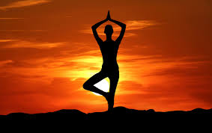
YOGA

Slide 3
ASANA IN YOGA
Asana is the physical practice of yoga poses.

Slide 4
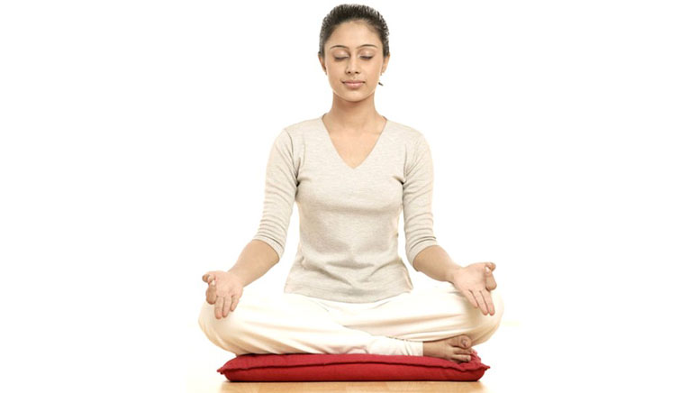
PADMASANA

Slide 5
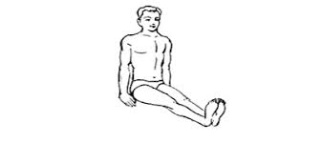
How To Do Padmasana Yoga (Step by Step)
Sit on a mat with legs stretched out in front of you while keeping the spine erect.
Bend the right knee and place it on the left thigh. Make sure that the sole of the feet point upward and the heel is close to the abdomen.
Now, repeat the same step with the other leg.

Slide 6
Padmasana Yoga (Step by Step)
With both the legs crossed and feet placed on opposite thighs.
Place your hands on the knees in mudra position. Keep the head straight and spine erect.
Hold and continue with gentle long breaths in and out.

Slide 7
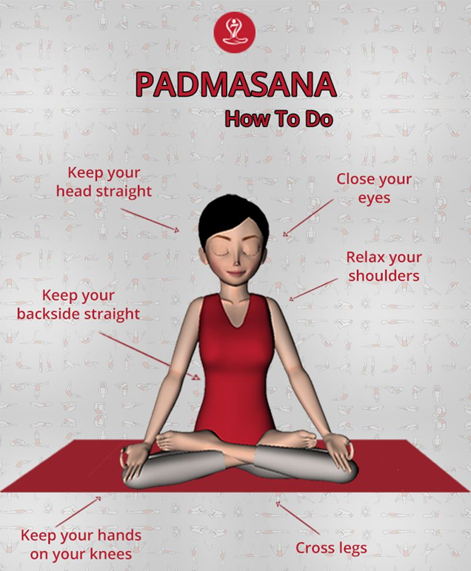

Slide 8
Padmasana (Lotus Position)

Slide 9
Benefits of the Padmasana (Lotus Position)
Improves digestion.
Strengthens knee and ankle joints
Reduces menstrual cramps
Awakens your consciousness
Fights insomnia
Improved posture and healthy spine
Reduces muscular tension

Slide 10
Benefits of the Padmasana
Improves circulation and respiration
Restores energy level
Alleviates mental stress

Slide 11
THANK YOU

